Slide 1
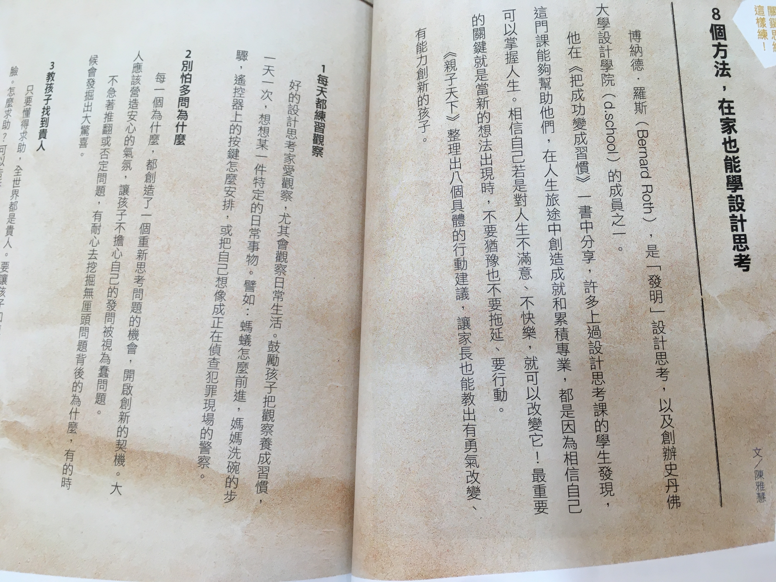
設計思考專書

Slide 2
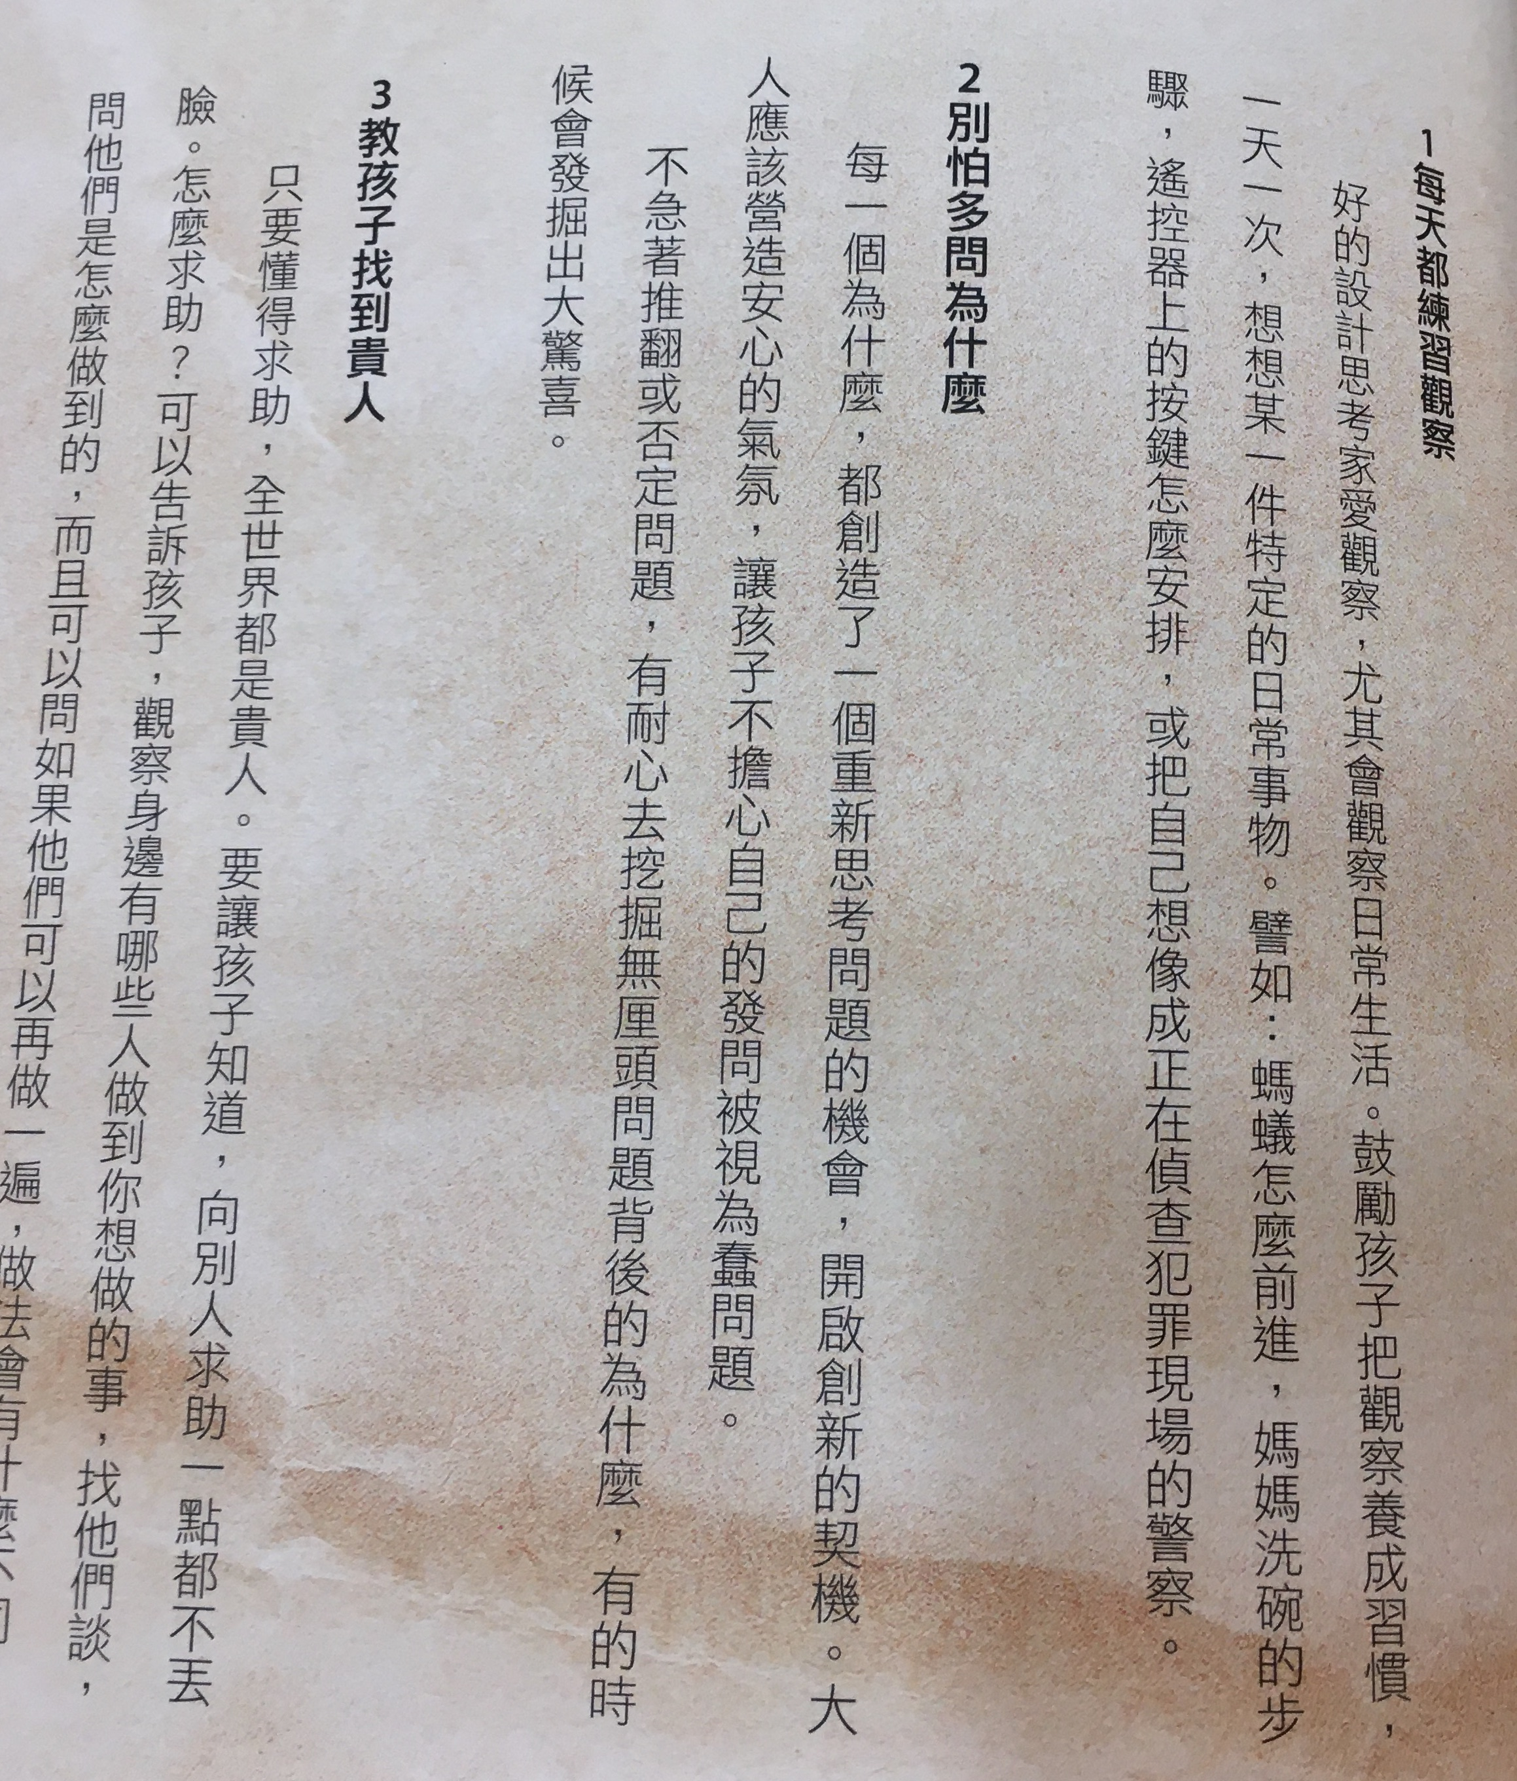
設計思考專書

Slide 3
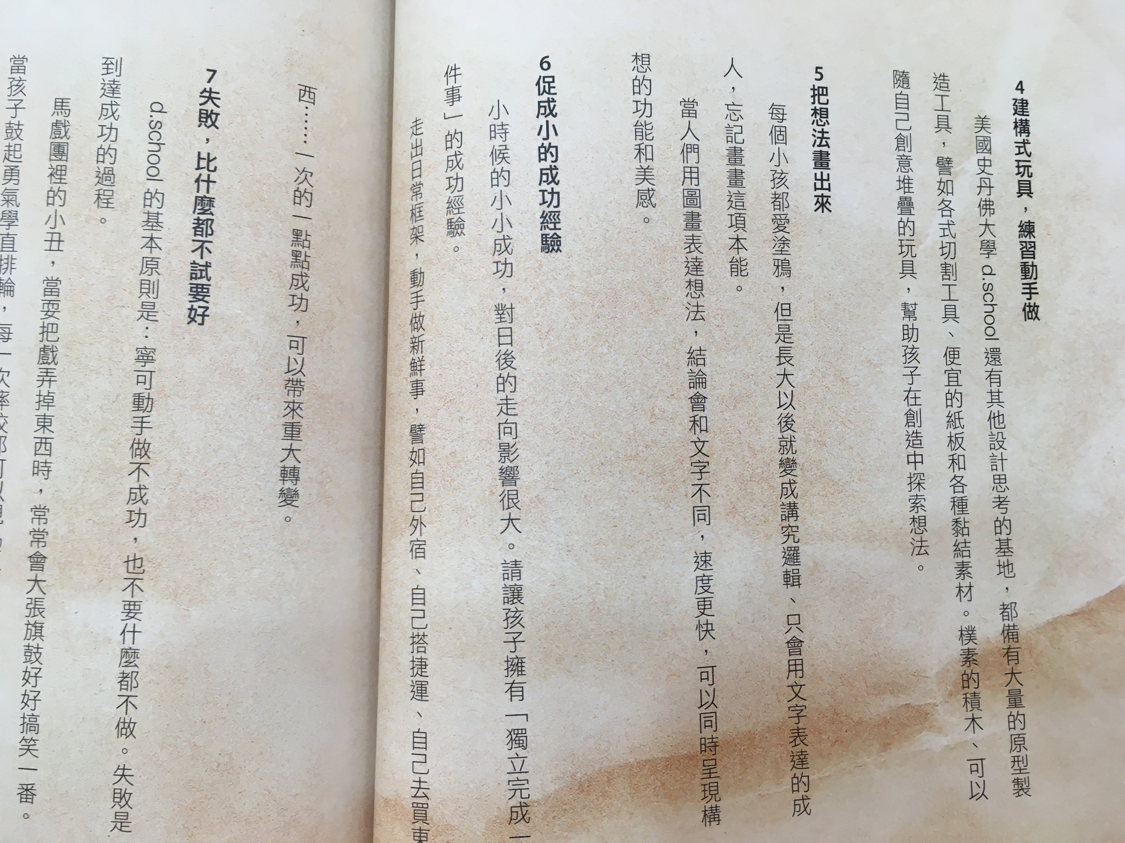
設計思考專書

Slide 4
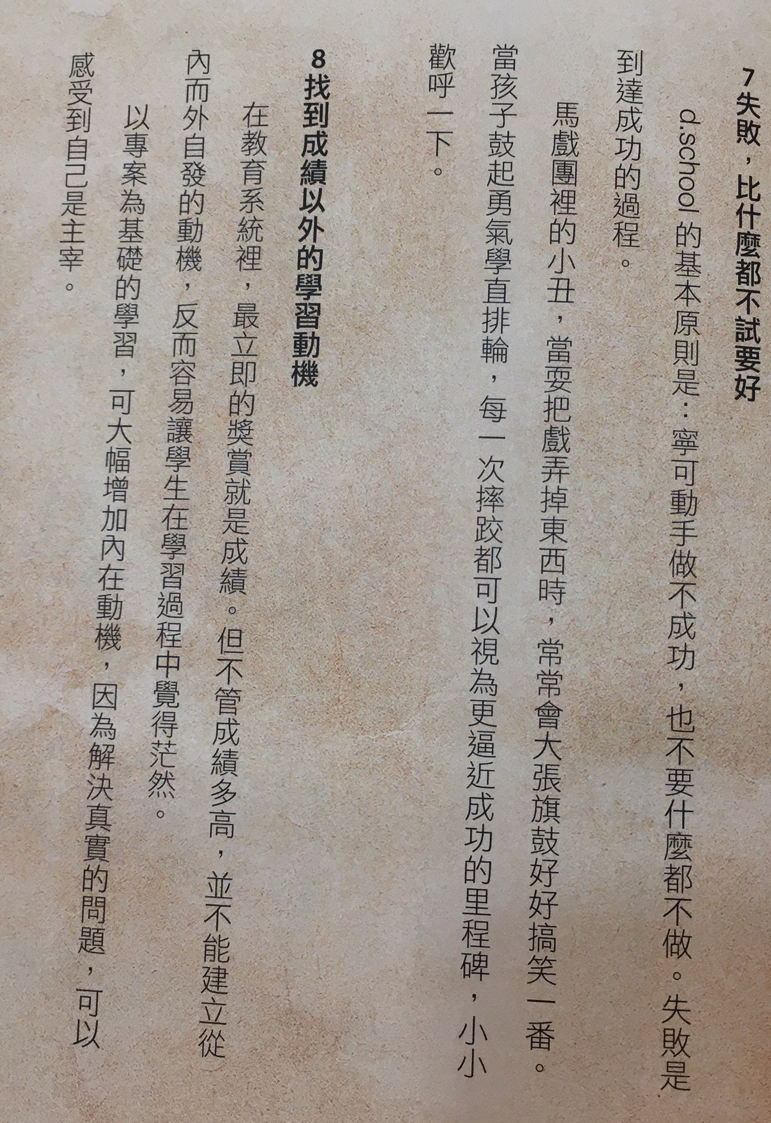
設計思考專書

Slide 5
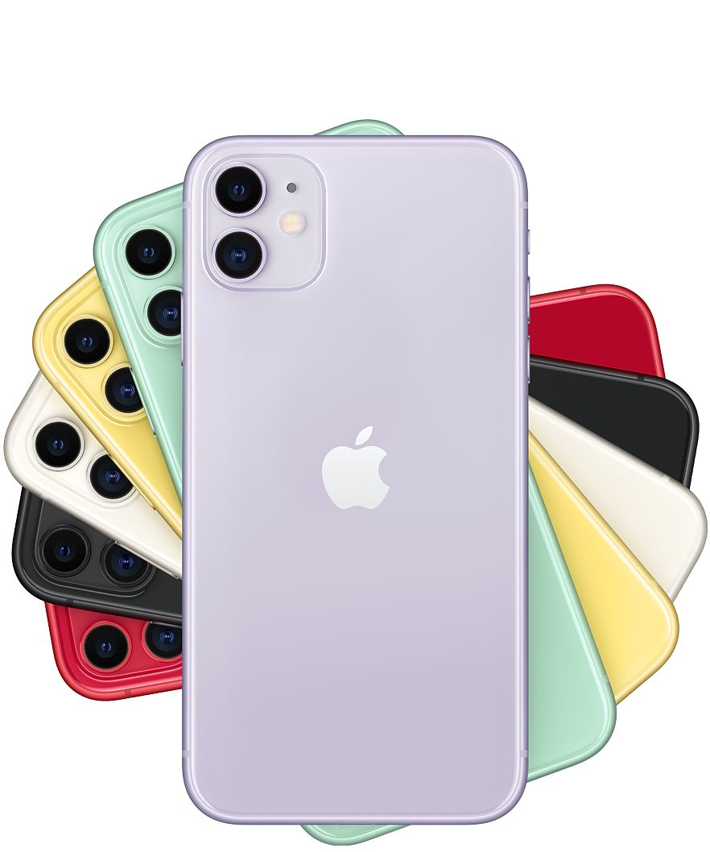
Design
Why Design?
Why do most young people prefer Apple products?
Why are Ikea products so popular?

Slide 6
NTU Design Book
Empathize
Define
Ideate
Prototype
Test

